Slide 1
FRED @St.Louis FED
An introduction to the Tool
Mike Aguilar | aguilar-mike@outlook.com | https://www.linkedin.com/in/mike-aguilar-econ/

Slide 2
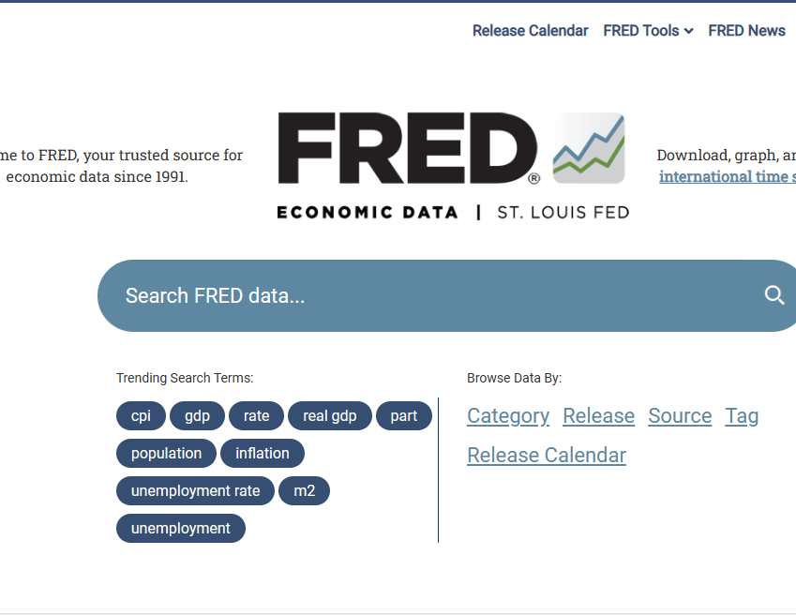
Outline of this tutorial
Meet FRED
Charting with FRED
Search FRED
FRED account features
Meet FRED

Slide 3
What is fred?
https://fred.stlouisfed.org/
FRED
Government & Private
Domestic & International
Time Series & Cross Section
Macro & Financial
Free, high quality, not “real time” updates
Charting, Data Download & API
Fred is a data aggregator; i.e. a database of databases

Slide 4
Fred use cases?
Quick data reference
Download data for analysis in statistical packages
Charting
Analysis on the FRED platform
FRED can be used in myriad ways.
The list nearby ranks the likely uses cases students/practitioners of macro will likely face.

Slide 5
Outline of this tutorial
Meet FRED
Charting with FRED
Search FRED
FRED account features
Charting with FRED

Slide 6
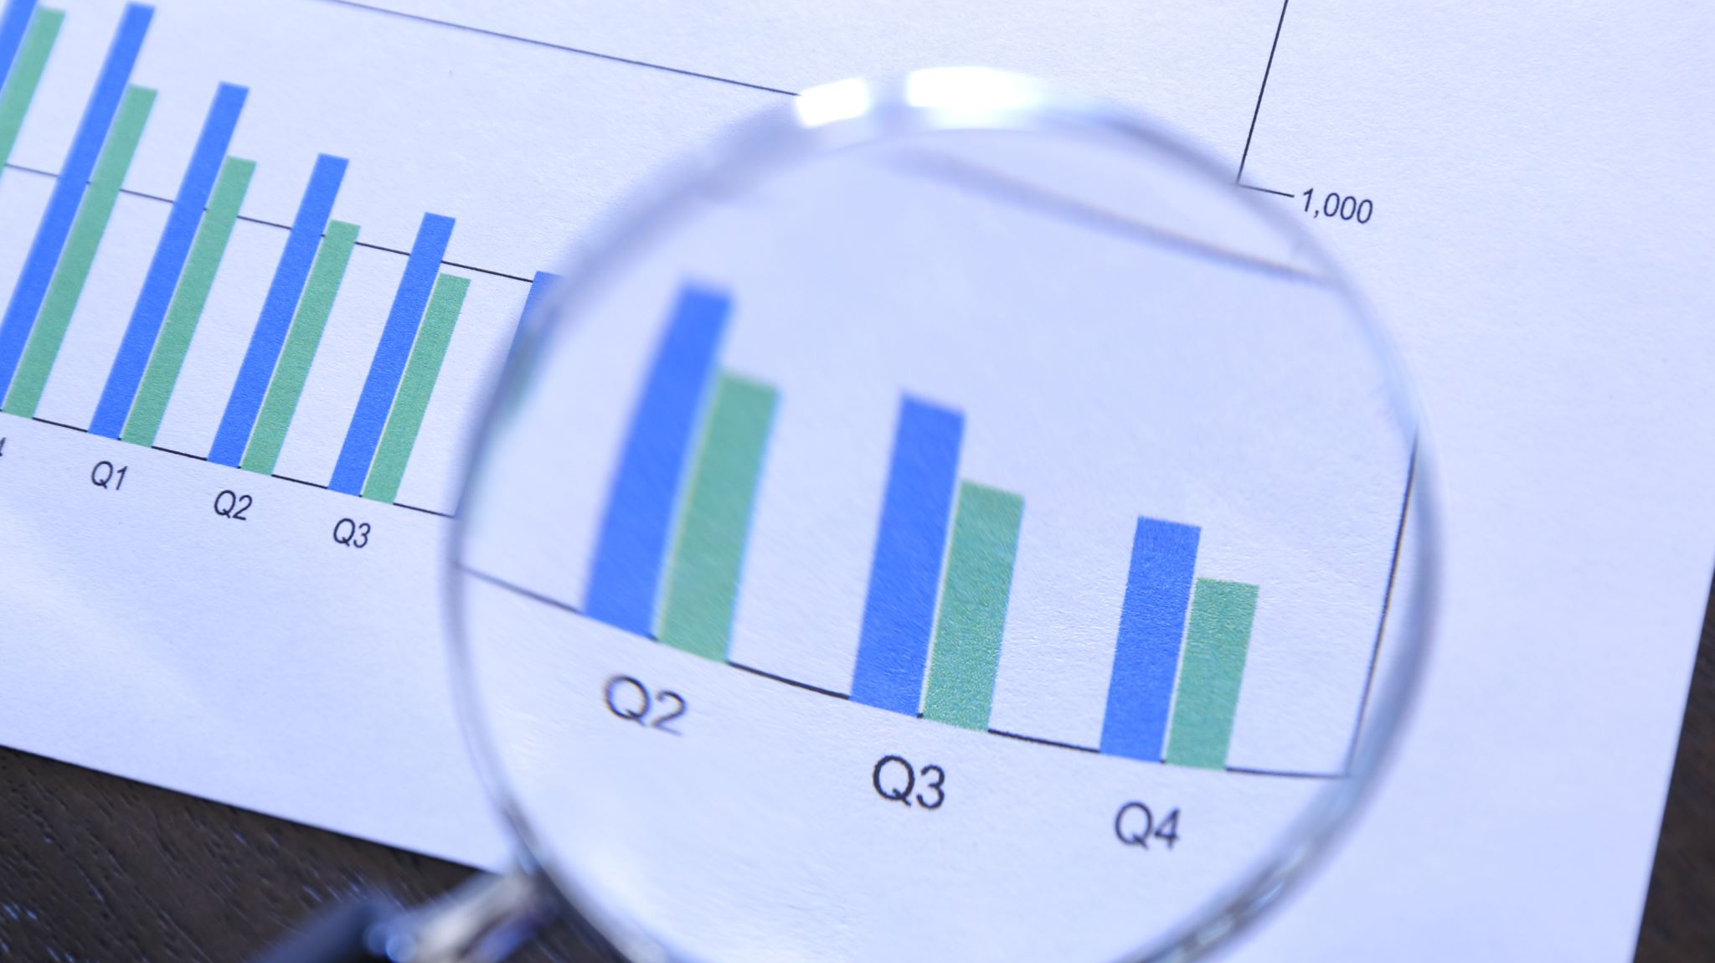
Charting with FRED
The following slides contain charts that are designed to highlight a variety of FRED’s advanced charting and data transformation tools.

Slide 7
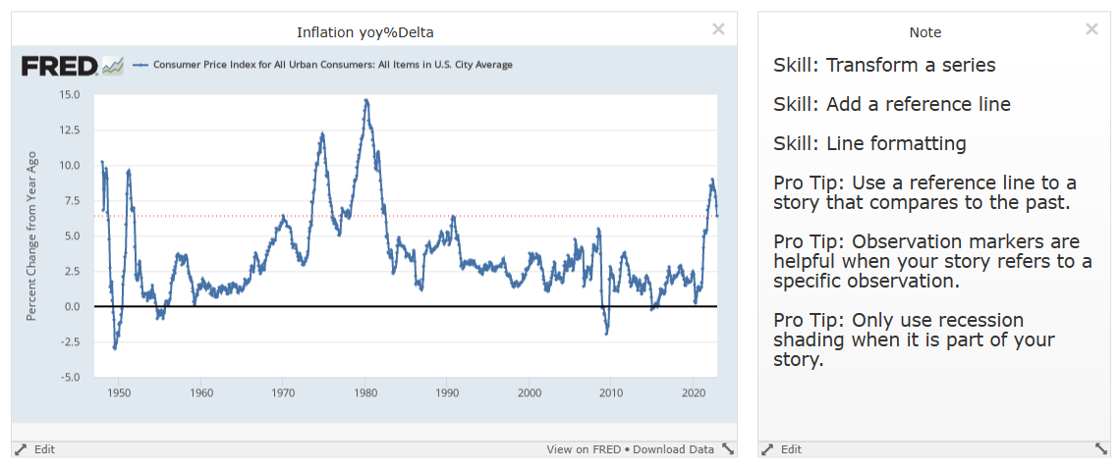
FRED TICKER: CPIAUCSL

Slide 8
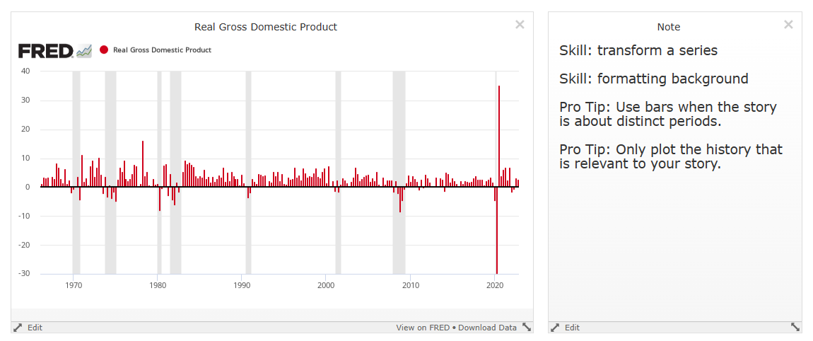
FRED TICKER: GDPC1

Slide 9
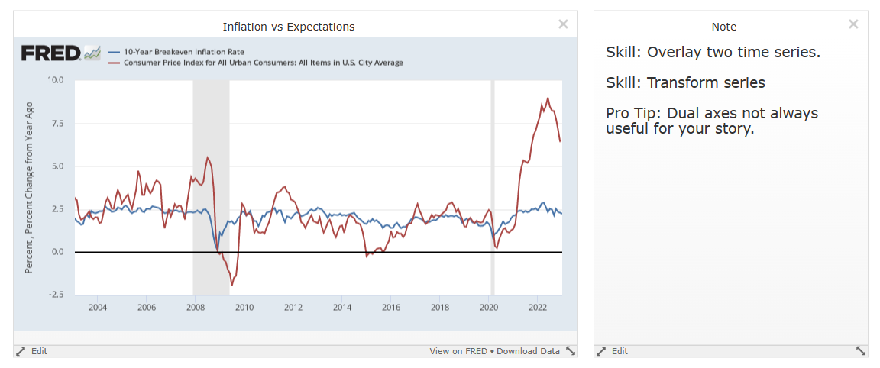
Search for CPI via AT A GLANCE
10yr ticker: T10YIE

Slide 10
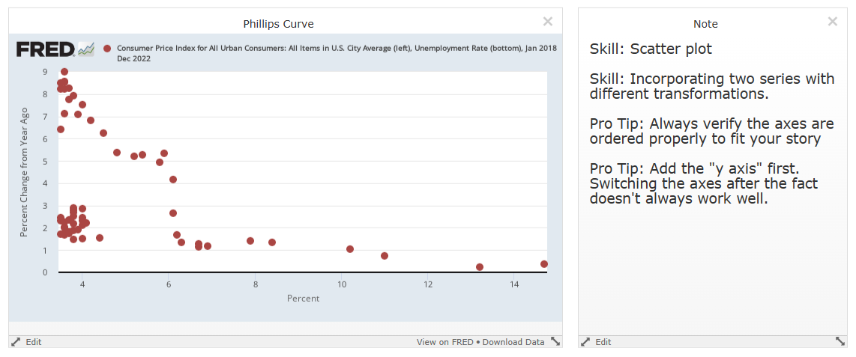
Access CPI via AT A GLANCE
Add FRED TICKER UNRATE

Slide 11
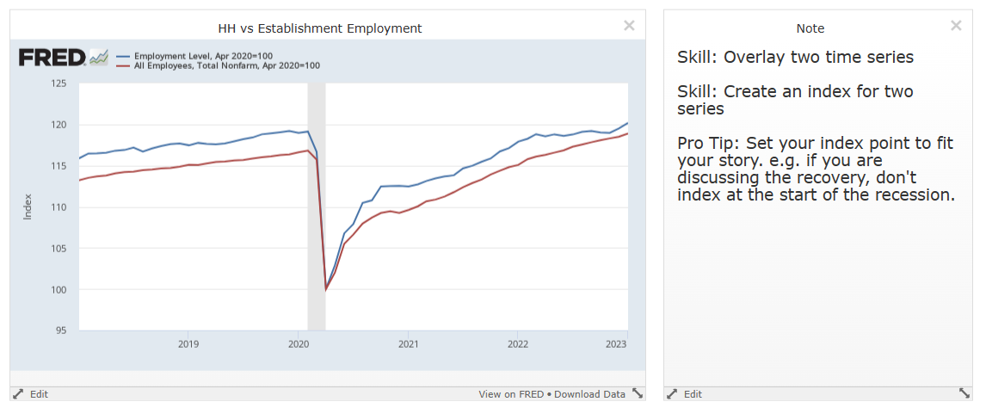
FRED TICKERS: CE16OV, PAYEMS

Slide 12
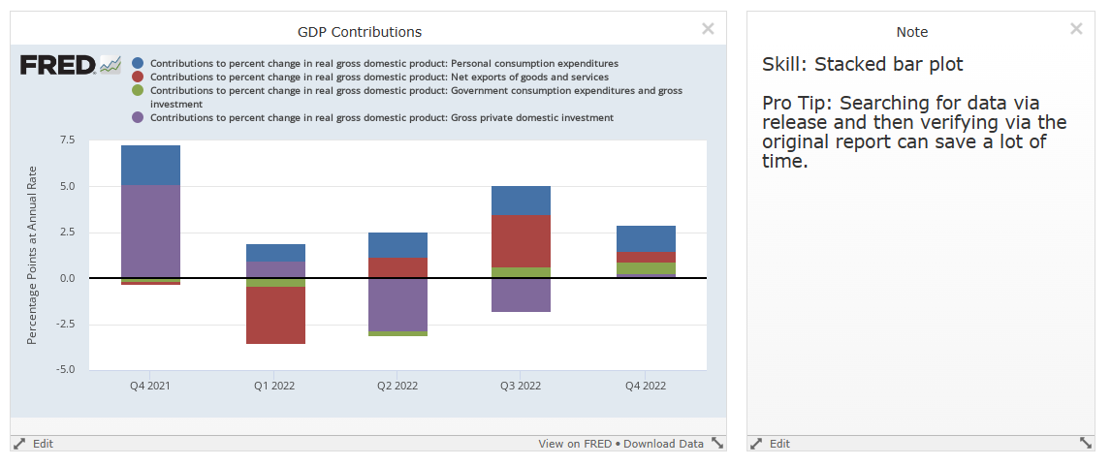
Scroll within Releases for Gross Domestic Product.
Section 1
Table 1.1.2, Quarterly
Lines 2, 7, 15, 22

Slide 13
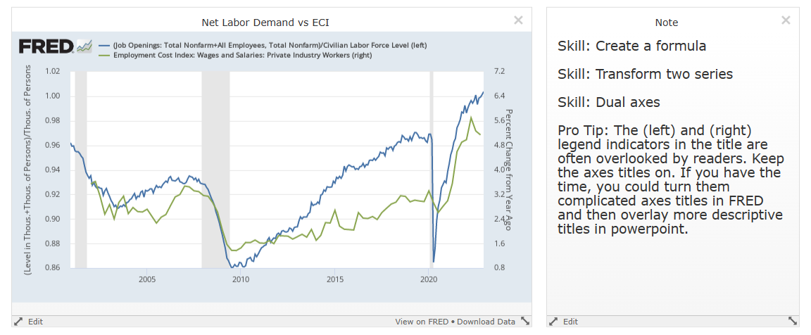
FRED TICKERS for Net Labor Demand: (JTSJOL + PAYEMS) / CLF16OV
FRED TICKER for ECI: ECIWAG

Slide 14
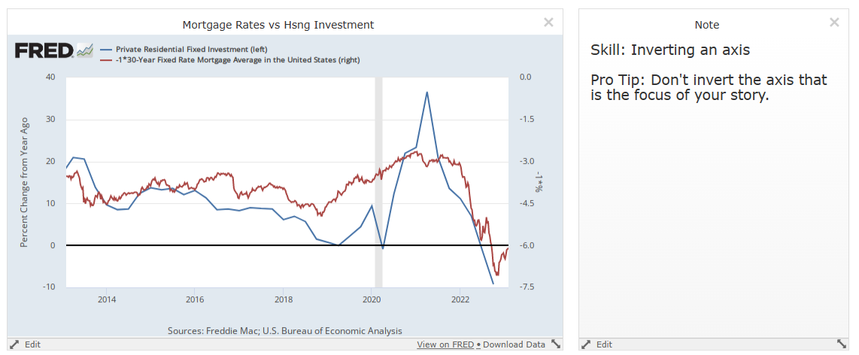
FRED TICKERS: PRFI, MORTGAGE3OUS

Slide 15
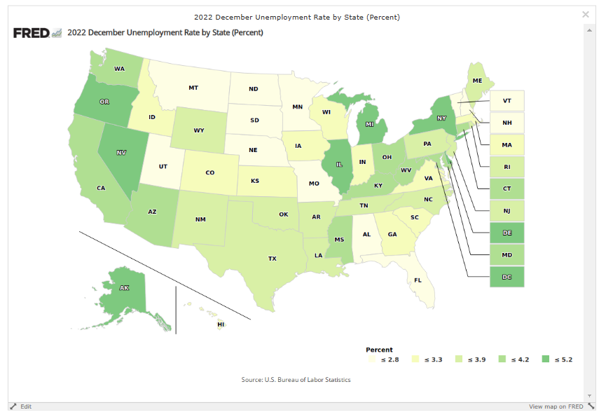
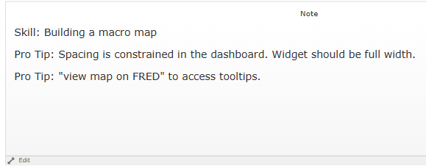
FRED TICKER: CAUR

Slide 16
exporting
Any charts you produce on FRED can be exported as Image, PDF, or PPT.
Any of the underlying data can be exported to XLSX or CSV.

Slide 17
Outline of this tutorial
Meet FRED
Charting with FRED
Search FRED
FRED account features
Search FRED

Slide 18
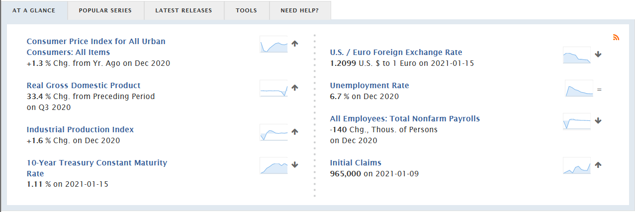
How do I find data on fred? Quick reference to key data

Slide 19
How do I find data on fred? Front page options
Some of the most popular series searched for on FRED
Currently released data with Calendar

Slide 20
How do I find data on Fred? Fred search bar
A simple search bar
Pro Tip: I’ve found that google’s search is more powerful. Simply google “data fred XXX” to find your series/category.

Slide 21
How do I find data on Fred? Fred search bar
Pro Tip: browsing by release is helpful because the mnemonics used by FRED sometimes don’t match that used in the official data releases.

Slide 22
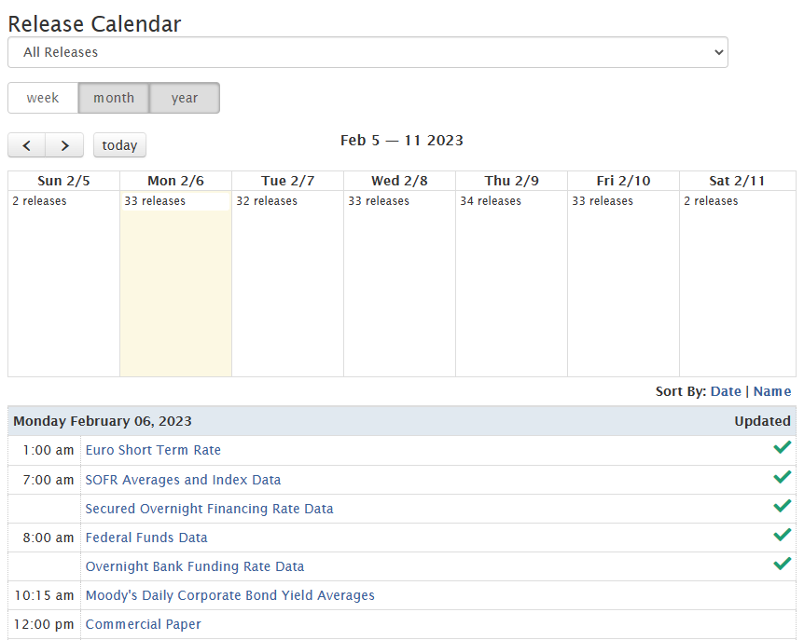
How do I find data on Fred? Browse by Release Calendar
Pro Tip: Use Econ Calendars like those from the WSJ, Trading Economics, etc..to get a sense of the consensus forecast.
Use FRED’s calendar finding data.

Slide 23
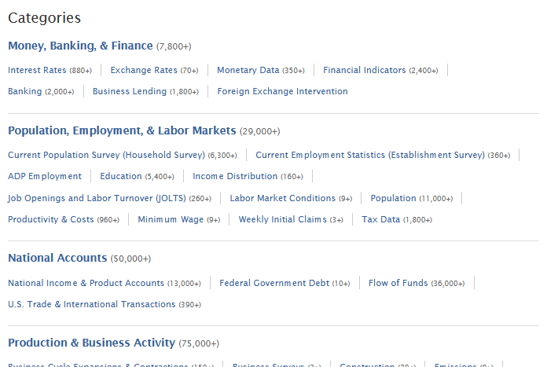
How do I find data on Fred? Browse by category

Slide 24
How do I find data on Fred? Reference the snapshot

Slide 25
Outline of this tutorial
Meet FRED
Charting with FRED
Search FRED
FRED account features
FRED account features

Slide 26
Fred account
Pro Tip: create a free FRED account to keep track of key series.
Use Data Lists and/or Dashboards.

Slide 27
Data lists
You can browse published Data Lists created and shared by others.
You can create and share your own lists to reduce frictions with regular updating.

Slide 28
Dashboards
Dashboards provide a great visual reference.
You can create and share your own dashboards for key analyses.
Pro Tip: Use “Notes” in the dashboard to remind yourself of key definitional and computational items.
WARNING: updating feature is buggy. Recommend viewing “On FRED” (not dashboard) to ensure you have the most recent data.

Slide 29
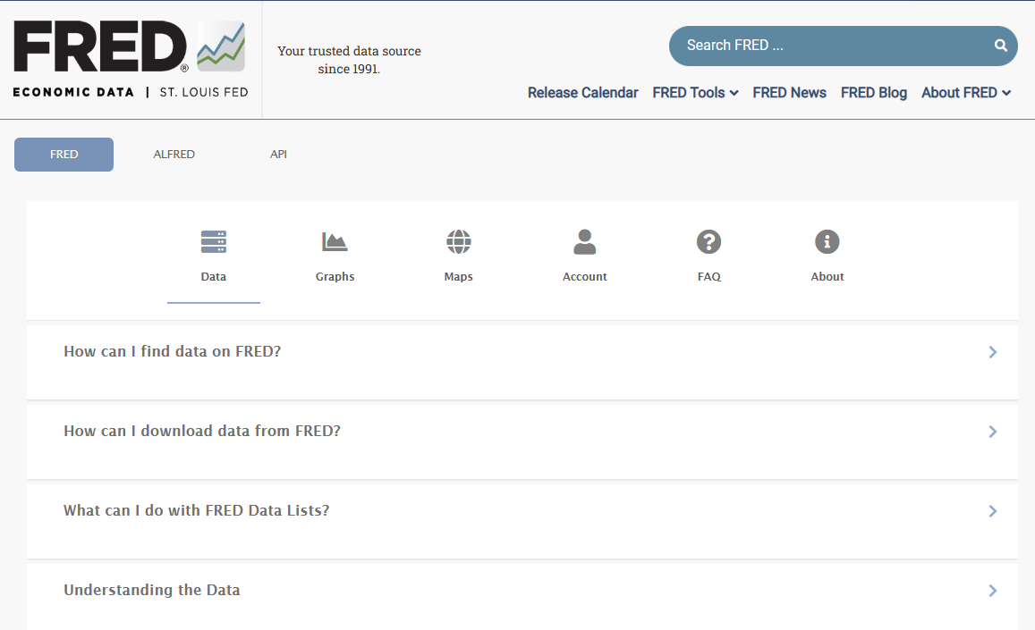
Outline of this tutorial
Meet FRED
Charting with FRED
Search FRED
FRED account features
Dashboard with this tutorial’s charts: https://fredaccount.stlouisfed.org/public/dashboard/92488
There are myriad resources on the FRED website to keep learning.
Pro Tip
FRED is the #1 free resource of data for anyone working in macro, finance, or policy.

