Slide 1
ECON CALENDARS
AN INTRODUCTION TO THE TOOL

Slide 2
WHAT IS AN ECON
CALENDAR?
A tool to track the systematic release of economic data
Focuses primarily on quantitative information (e.g. monthly CPI report), but also contains some important qualitative information (e.g. speeches by Fed chairs)

Slide 3
WHERE CAN I FIND
ECON CALENDARS?
There are many paid offerings (Econoday being among the best).
Here are a few free versions.
Trading Economics
https://tradingeconomics.com/calendar
Investing.com
https://www.investing.com/economic-calendar/
MarketWatch
https://www.marketwatch.com/economy-politics/calendar

Slide 4
ANATOMY OF AN ECONOMIC CALENDAR
What happened during
What happened during last coverage period?
Release Date
this coverage period?
Forecast from this particular service
Release Time
TradingEconomics.com
Data Concept
Coverage Date
Average expectations from professional economists

Slide 5
COVERAGE VS
RELEASE
Notice that in the prior slide the “Coverage Date” was December, but the “Release Date” was January.
What’s the difference between the coverage date and the release date?
All economic indicators are released with a lag. It takes time to gather, compile, clean, and release official indicators.
Some lags are one week (e.g. Jobless claims), while some are quarters or years (e.g. GDP).
The COVERAGE (or Activity) date tells me when the economic activity took place.
The RELEASE date tells me when the indicators are made publicly available.

Slide 6
PREVIOUS VS CONSENSUS / FORECAST
I understand why I need the “actual” indicator, but why do I need previous and consensus (forecast) measures?
We are using the calendar like detectives, attempting to
tell a story.
The “actual” indicator gives us a snapshot in time.
Combining with the “previous” value permits us to
uncover a trend, and thereby tell a richer story.
Expectations are a vital component of economic behavior. The “consensus” (“forecast”) permits us to compare what happened to what we expected.

Slide 7
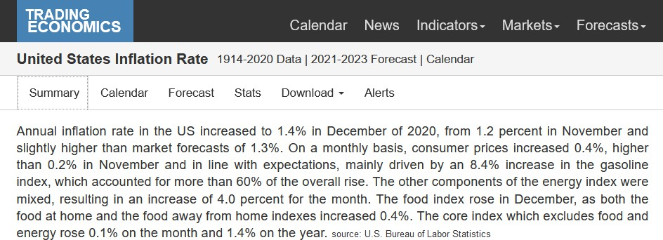
INTERPRETATION
Most calendar services provide some quick analysis.
TradingEconomics.com

Slide 8
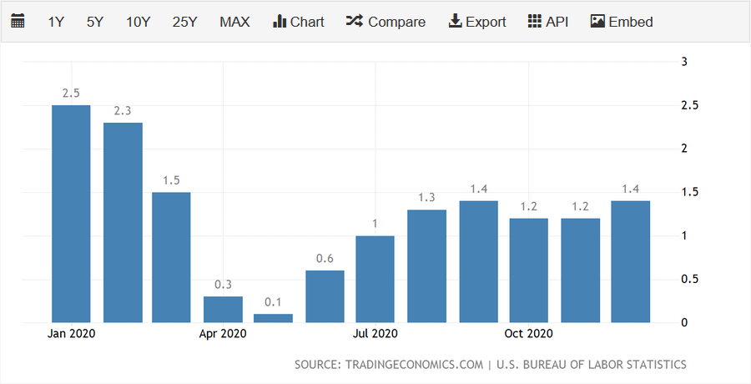
HISTORICAL PERSPECTIVE
Although the format may vary, almost all calendar services provide a time series of the data release.

Slide 9
DEFINITION
A quick description is often included.
Be sure to check the original data provider for details.
Snapshot of TradingEconomics.com

Slide 10
SOURCE
TradingEconomics.com
The data provider is usually linked/cited

Slide 11
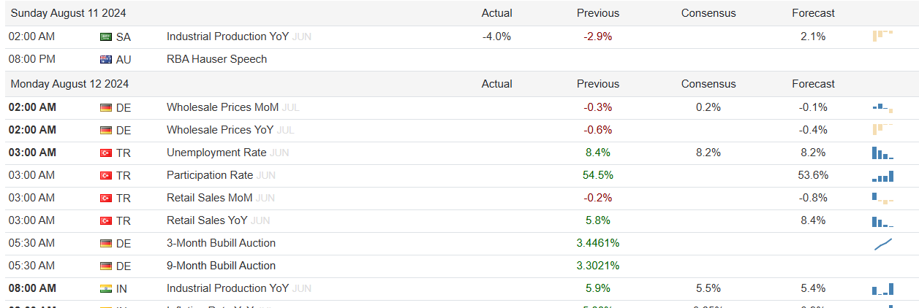
NOT EXHAUSTIVE
Despite the abundance of data, these Calendars are far from exhaustive. Typically, only the most important statistics are reported on the calendar (e.g. GDP, CPI, etc..). Accompanying each of these major statistics are a dozens of related statistics. For instance, when the headline GDP number is released, the BEA also produces detailed information regarding consumption, investment, net exports, and government expenditures, none of which are tracked directly within the Econ Calendar, but all of which may be useful to your analysis. Moreover, there is an abundance of qualitative information that may not be on the calendars.
TradingEconomics.com

